Slide 1
Smart Yoga Mat Using Arduino
Presented by
Harini S (927623BEC070)
Jothisha V (927623BEC093)
Joy Sherly J (927623BEC094)
Kabelashree R (927623BEC096)

Slide 2
Abstract
The Smart Yoga Mat is an Arduino-based health monitoring system designed to enhance user safety and awareness during yoga and fitness exercises. It incorporates a heart rate sensor (HW-827) and a temperature sensor (LM35) to continuously monitor physiological parameters such as pulse and body temperature. The system provides real-time data feedback to help users maintain optimal exertion levels and prevent overexertion. With potential for integration into fitness tracking or telemedicine platforms, this project aims to create an affordable, portable, and user-friendly solution for health-conscious individuals.

Slide 3
Problem Statement
Traditional yoga mats provide no feedback on a user's physiological condition during exercise. This lack of monitoring can lead to unnoticed overexertion, dehydration, or other health risks, especially for beginners, elderly individuals, or people with underlying medical conditions. There is a growing need for a smart, accessible system that can offer real-time health monitoring during physical activities like yoga.

Slide 4
Existing Methodology
Existing smart health solutions often include wearable fitness trackers (e.g., smartwatches, fitness bands) that monitor heart rate and temperature. These devices, however, can be expensive, may not be comfortable during yoga (especially in poses where contact is minimal), and often lack integration with the mat or exercise surface. Some commercial smart mats exist but are high-cost and limited in customization or local implementation using open-source tools like Arduino.

Slide 5
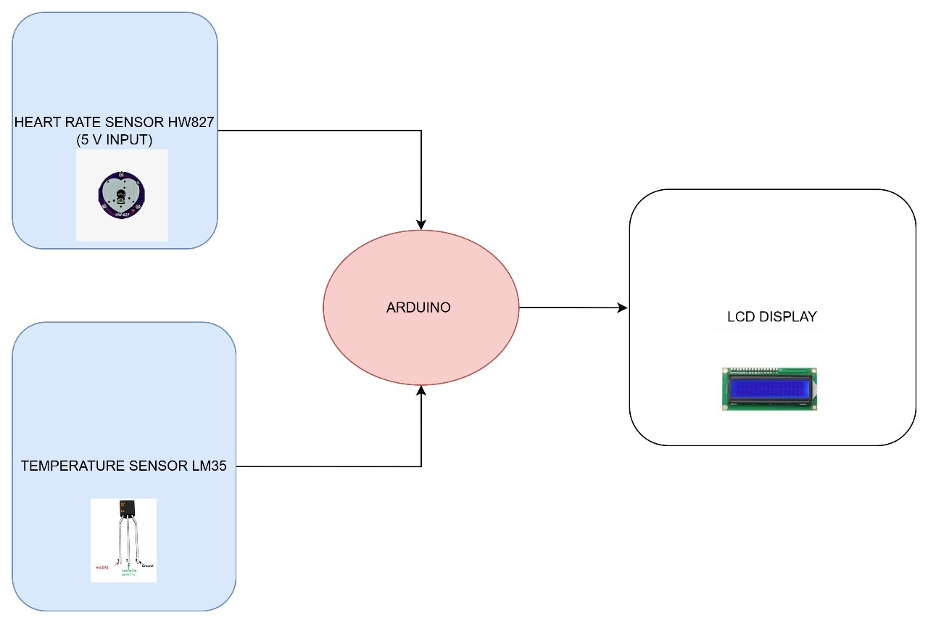
Block diagram

Slide 6
Novelty of Proposed Method
Integrates vital monitoring directly into the yoga mat instead of external wearable devices. Uses low-cost, readily available sensors (HW-827 and LM35) to ensure affordability and DIY scalability. Focused on contact-based monitoring through the mat surface, increasing comfort and minimizing distraction during yoga. Offers potential for integration with other sensors (e.g., pressure sensors, posture correction) in future versions. Built using open-source hardware (Arduino), enabling customization and academic learning.

Slide 7
Proposed Methodology
The proposed methodology integrates heart rate and temperature monitoring into the yoga mat using an Arduino microcontroller. The HW-827 heart rate sensor and LM35 temperature sensor are embedded within the mat to collect real-time data on pulse and body temperature. The Arduino processes this data and displays it on an OLED/LCD screen or Serial Monitor. Future enhancements may include wireless communication and additional sensors for posture analysis.

Slide 8
Implementation Results
The smart yoga mat integrates temperature sensors and a heart rate sensor with an Arduino microcontroller to provide real-time feedback during yoga sessions. The system continuously monitors the user's heart rate and temperature thereby enhancing the effectiveness of their practice.

Slide 9
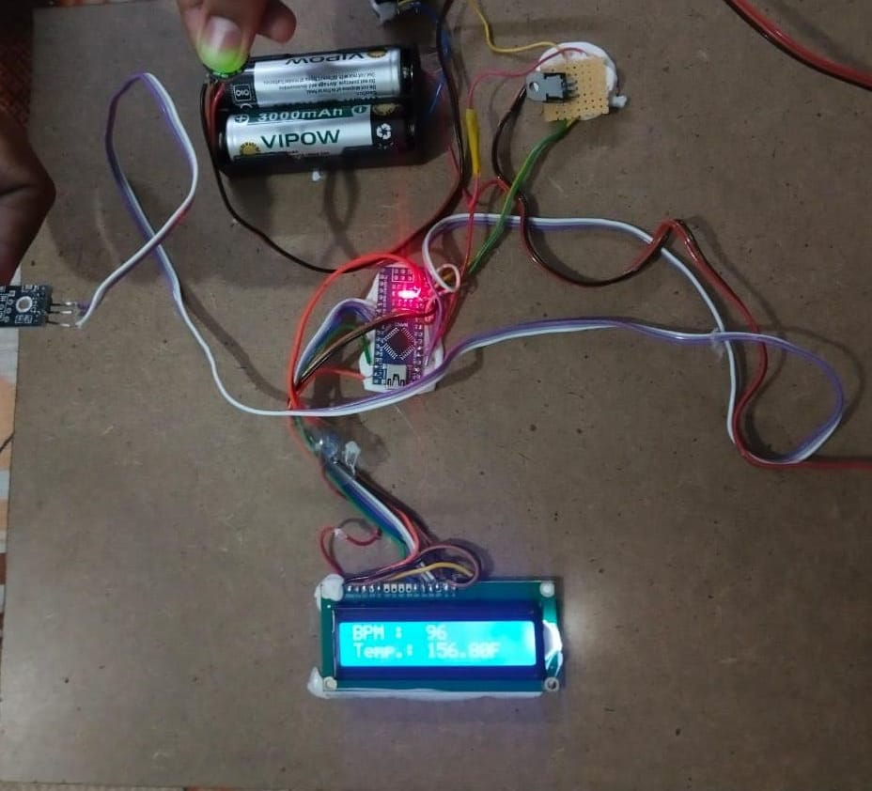
Result and Discussion

Slide 10
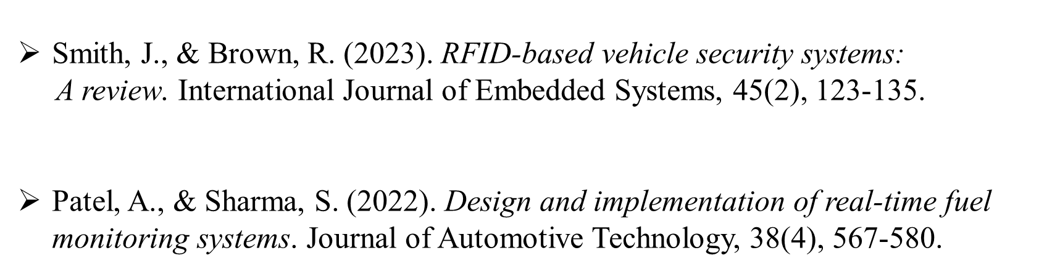
References

